Slide 1

Real OR Fake Jobs
Dominik Mika, IM UWr
Kacper Toczek, IM Uwr

Slide 2
About the Dataset
This dataset contains 18K job descriptions out of which about 800 are fake. The data consists of both textual information and meta-information about the jobs. The dataset can be used to create classification models which can learn the job descriptions which are fraudulent.
https://www.kaggle.com/datasets/whenamancodes/real-or-fake-jobs

Slide 3
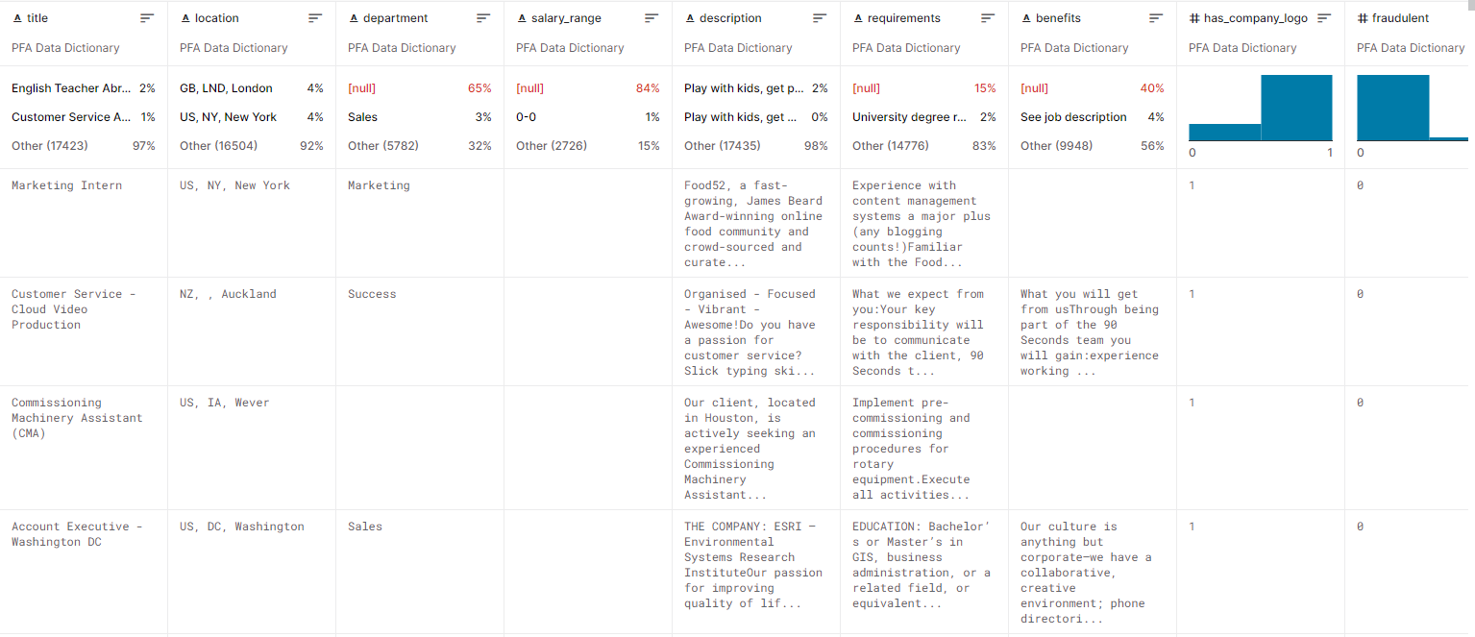
Dataset snapshot

Slide 4
Our goal
Create a classification model that uses text data features and meta-features and predict which job description are fraudulent or real.

Slide 5
Methods
Text mining, processing: NLTK, Word2Vec
Classification: Logistic regression, SVM, Decision trees, XGBoost

